Slide 1

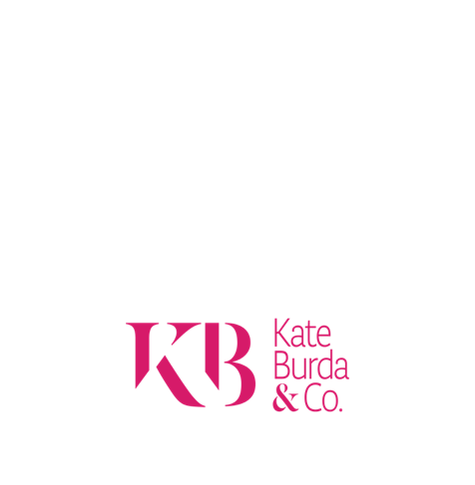
What Good Looks Like: Revenue Strategy
Do Less.
Make it mean more.

Slide 2
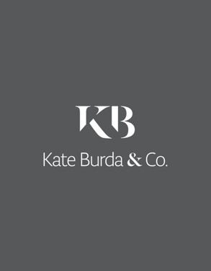
1
Unlocking the Power of Aligning Financial and Commercial Strategy
What Good Looks Like: Revenue Strategy I 2024
3

Slide 3

Unlocking the Power of Aligning Financial and Commercial Strategy
Companies leave money on the table every day due to the misalignment between financial strategy and sales and marketing execution. And it is draining profits and energy. This hidden yet significant issue can quietly undermine your business's growth and profitability.
Misalignment isn’t just a minor hiccup—it’s a chronic ailment that can cost U.S. businesses over $1 trillion annually. With only 8% of companies claiming strong alignment between their sales and marketing teams, the issue is more prevalent than you might think. Without alignment, operational efficiencies suffer, revenue opportunities slip through the cracks, and your company’s full potential remains untapped.
The headstones within this cemetery are so well known. From Blockbuster to Kodak. Borders Book Store to JCPenney, all have fallen victim to this mission-critical relationship between financial vision to commercial teams effectively carrying it out. Only 23.2% of sales professionals say their organizations are aligned in strategies from financial vision to strategies and processes.
Identifying Signs of Misalignment
Misalignment often lurks beneath the surface, silently sabotaging your organization's success. Identifying the telltale signs is the first step toward rectifying this costly issue. Are your financial and marketing teams speaking the same language? 79% chance they don’t.
What Good Looks Like: Revenue Strategy I 2024

Slide 4

Unlocking the Power of Aligning Financial and Commercial Strategy
Typical areas of concern include misaligned metrics, where financial teams focus on revenue growth, and sales teams chase new customer acquisition. This divide can lead to neglected upselling opportunities and stunted growth. Inconsistent messaging further compounds the problem, where marketing positions a company as low-cost while finance pushes for higher-margin deals, confusing potential customers and hindering larger contracts. Resource allocation often suffers, too, with financial conservatism stifling marketing's ability to reach new market segments.
By identifying these signs, you can proactively address misalignment and lay the foundation for a more cohesive strategy.
Misalignment also hampers productivity, with 40% of companies reporting sales and marketing teams measured by different metrics—a significant hindrance to collaboration. This disconnect translates into inefficiencies, wasted resources, and suboptimal decision-making. Furthermore, a lack of alignment can erode customer trust, leading to higher churn rates and missed opportunities to build lasting relationships.
Addressing misalignment is not merely about optimizing processes; it's about unlocking your company's full potential and driving sustainable growth.
The Negative Impacts of Misalignment
The consequences of misalignment can be dire. Operational inefficiencies, lost revenue opportunities, and diminished customer satisfaction are just the tip of the iceberg. Businesses with poor alignment experience a 4% revenue decline, while those with solid alignment enjoy a 20% annual growth rate. The gap is substantial, underscoring the critical importance of addressing misalignment.
What Good Looks Like: Revenue Strategy I 2024

Slide 5

Unlocking the Power of Aligning Financial and Commercial Strategy
Case Study 1: TechInnovate's Misaligned Growth Strategy
TechInnovate, a mid-sized software company, set an ambitious goal to double its revenue within three years. However, the misalignment between their financial and marketing strategies led to significant challenges. Their finance team focused solely on revenue growth, while the sales team's compensation structure prioritized new customer acquisition over expanding existing accounts. This misalignment resulted in neglected upselling opportunities and stunted growth.
Adding to the complexity, the marketing team continued positioning TechInnovate as a low-cost provider, contradicting the finance team's push for higher-margin enterprise deals. This inconsistency confused potential customers, making it challenging to close larger contracts. Furthermore, a conservative approach to marketing spend limited their ability to reach new market segments and generate qualified leads.
After 18 months, TechInnovate achieved only a 15% revenue increase, falling far short of their goal. By realigning sales compensation, marketing messaging, and resource allocation to support their financial vision, they ultimately achieved a 75% revenue increase by the end of the third year.
What Good Looks Like: Revenue Strategy I 2024

Slide 6
Unlocking the Power of Aligning Financial and Commercial Strategy
Case Study 2: RetailGiant's Omnichannel Disconnect
RetailGiant, a large brick-and-mortar retailer, recognized the need to invest heavily in e-commerce to remain competitive. However, their financial strategy, sales, and marketing execution failed to support this digital transformation. Channel conflict arose as the in-store sales team viewed e-commerce as threatening their commissions discouraging customers from using online services. This disjointed experience hindered the adoption of new digital channels.
Despite the significant investment in e-commerce infrastructure, the marketing team allocated 80% of their budget to traditional advertising, neglecting digital channels crucial for driving online sales. Furthermore, siloed customer data prevented a unified view of customer behavior, impeding personalized marketing efforts.
RetailGiant's e-commerce sales grew at only 5% year-over-year, compared to the industry average of 15%. Realigning sales incentives, marketing focus, and data systems to support their omnichannel vision accelerated e-commerce growth to 25% within 18 months.
Expert Perspectives on Alignment
Industry experts emphasize the importance of alignment in driving business success. Phil Fernandez, CEO of Marketo, asserts, "When sales and marketing teams unite around a single revenue cycle, they dramatically improve marketing return on investment, sales productivity, and, most importantly, top-line growth."
Lori Wizdo, Principal Analyst at Forrester Research, underscores the significance of shared definitions, stating, "The best-in-class companies are those that have a clear definition of a qualified lead agreed upon by both sales and marketing."
These insights highlight the need for shared goals, open communication, and collaborative strategies to achieve alignment and drive growth.
What Good Looks Like: Revenue Strategy I 2024

Slide 7
Unlocking the Power of Aligning Financial and Commercial Strategy
Actionable Steps for Achieving Alignment
To address misalignment and unlock your company's full potential, consider the following actionable steps:
Initiate a comprehensive review of current financial and commercial strategies to identify areas of misalignment. This assessment will serve as the foundation for alignment efforts.
Apply rigor to the not just the math of financial growth, but the financial validity of supporting strategies and tactics are feasible and align.
Develop shared KPIs and metrics that reflect alignment objectives. This collaborative approach enables both teams to measure success collectively.
Invest in technology and tools that facilitate collaboration and transparency. Shared CRM systems and integrated analytics platforms can bridge departmental gaps. We have developed Ignite to be able to do create a revenue roadmap with supporting strategies.
Raucously apply rigor in critical thinking and challenge is this something that we have always done or is there a better way to get to the result. Kill the status quo thinking will win the day.
Bring in outside in thinking. Not only bring it in but give it a seat at the table. We will be unpacking this in the next few days of how differentiated thinking wins the day.
Misalignment between financial strategies and sales/marketing execution can significantly impact a company's performance. Businesses can achieve and maintain alignment by proactively identifying signs of misalignment, implementing open communication, shared metrics, and a culture of collaboration.
What Good Looks Like: Revenue Strategy I 2024

